Slide 1
Structure of the Earth Year 9 Earth and Space

Slide 2
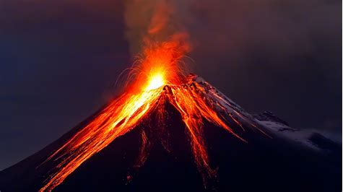
Learning Objective
CFU
What are we going to learn?
Identify the layers of the Earth.
Describe the composition of each layer.
Activate Prior Knowledge
Think, Pair, Share: What comes out of volcanoes? Where does it come from?

Slide 3
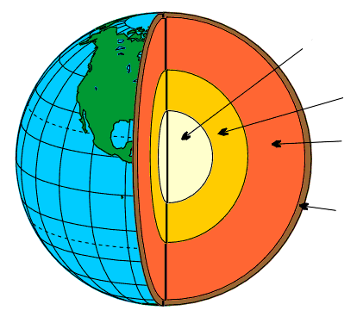
Concept Development
CFU 1
What is a property?
Earth’s Structure
The Earth has four main layers.
Each layer has its own properties.
The four layers are:
CFU 2
Which layer is the outermost layer?
CFU 3
Which layer is the innermost layer?
Inner core
CFU 4
Which layer is the thinnest layer?
Outer core
Mantle
Crust
Vocabulary
Property: characteristic, feature or quality

Slide 4
Concept Development
CFU 1
What two metals is the inner core made out of?
Inner Core
Made of solid iron and nickel
It is approximately 2500km in diameter
Depending on the depth, the temperature is between 5000-6000°C
The inner core stays solid because of the immense pressure surrounding it
CFU 2
What is the temperature range in the inner core?
Inner core
Outer core
Mantle
Crust
Notes:
CFU answers from previous slide: 1. A characteristic, feature, or quality. 2. The crust. 3. The inner core. 4. The crust.

Slide 5
Concept Development
CFU 1
What two metals is the outer core made out of?
Outer Core
Made of molten iron and nickel
It is approximately 2300km thick
Depending on the depth, the temperature is between 4000-6000°C
The outer core flows around the centre of the Earth
This movement creates our planet’s magnetic field
CFU 2
What is the temperature range in the outer core?
CFU 3
How are the inner and the outer cores similar?
Inner core
CFU 4
How are the inner and the outer cores different?
Outer core
Mantle
Crust
Vocabulary
Molten: liquid
Notes:
CFU answers from previous slide: 1. Iron and nickel. 2. 5000-6000°C.

Slide 6
Concept Development
CFU 1
What is the mantle made out of?
Mantle
Made of molten rock
It is approximately 2900km thick
Depending on the depth, the temperature is between 1000-3500°C
CFU 2
How are the mantle and the outer core different?
Inner core
Outer core
Mantle
Crust
Vocabulary
Property: characteristic, feature or quality Molten: liquid
Notes:
CFU answers from previous slide: 1. Iron and nickel. 2. 4000-6000°C. 3. They are both made from iron and nickel, similar temperature. 4. Inner core is solid, outer core is molten (liquid).

Slide 7
Concept Development
CFU 1
What is the crust made out of?
Crust
Made of solid rock
It is between 10km and 70km thick
The average temperature on the surface of the Earth is approximately 25°C
CFU 2
How thick is the crust?
CFU 3
How are the crust and the mantle similar?
Inner core
CFU 4
How are the crust and the mantle different?
Outer core
Mantle
Crust
Vocabulary
Property: characteristic, feature or quality
Notes:
CFU answers from previous slide: 1. Molten rock. 2. Outer core is hotter, made of iron and nickel. Mantle is made of molten rock.

Slide 8
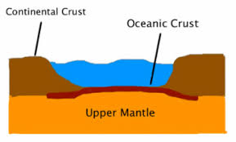
Concept Development
CFU 1
Which are the two types of crust?
Earth’s Crust
There are two different types of crust.
They are oceanic crust and continental crust.
The two types of crust are made up of different types of rocks.
CFU 2
How are the two types of crust different?
Notes:
CFU answers from previous slide: 1. Solid Rock 2. 10-70 km thick 3. They are both made of rock, 4. The mantle is hotter (1000-3500°C), and made of molten rock. The crust (25°C) is solid rock.

Slide 9
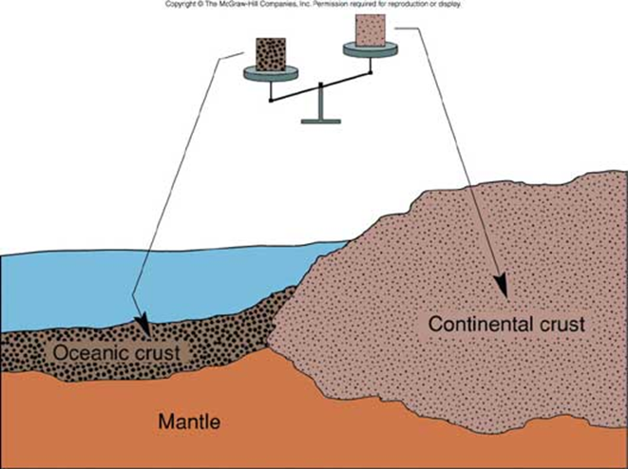
Concept Development
CFU 1
Where is the oceanic crust found?
Oceanic crust
It is found below the oceans.
It is between 6-11 km thick.
It is made of very young rocks. The rocks are not older than 200 million years.
It is denser than continental crust.
CFU 2
What type of rocks make the oceanic crust?
CFU 3
When the two types of crust meet, the oceanic crust will sink. Why?
Notes:
CFU answers from previous slide: 1. Oceanic and Continental crust. 2. They are made up of different types of rock.

Slide 10
Concept Development
CFU 1
Where is the continental crust found?
Continental crust
Continental crust forms the land.
It has an average thickness of 35 km.
It is less dense and therefore more buoyant than oceanic crust.
It is made of the oldest rocks on Earth.
CFU 2
How are the continental crust and oceanic crust different?
CFU 3
When the two types of crusts meet, why does the continental crust always rise above the oceanic crust?
Vocabulary
Buoyant : able to keep afloat
Notes:
CFU answers from previous slide: 1. Underneath the oceans. 2. Young (200 million years) dense rock. 3. Oceanic crust is more dense than continental, so will sink underneath.

Slide 11
Relevance
Understanding the structure of the Earth will help you understand the causes of natural phenomena's like earthquakes and volcanic eruptions.
Notes:
CFU answers from previous slide: 1. The land. 2. Oceanic crust is younger than continental, more dense. 3. Continental crust is less dense than oceanic, so will rise above it.

Slide 12
Skill Closure
Draw and label the layers of the Earth on your whiteboard.
(Mantle, Inner core, Crust, Outer core)
Skill Closure
State the differences between oceanic crust and continental crust.
Skill Closure
Even though it is the hottest part of the Earth, the inner core is not molten (a liquid). Explain why.

Slide 13
Independent Practice
Complete the Structure of the Earth worksheet, on paper or your device.

Slide 14
Skill Closure
ANSWERS
Draw and label the layers of the Earth on your whiteboard.
(Mantle, Inner core, Crust, Outer core)
Inner Core
Skill Closure
Outer Core
State the differences between oceanic crust and continental crust.
Continental crust is older and more less dense than oceanic crust, so will rise above it when they collide.
Mantle
Crust
Skill Closure
Even though it is the hottest part of the Earth, the inner core is not molten (a liquid). Explain why.
The inner core is extremely hot, but the pressure placed upon it by the other three layers of the Earth compact it into a solid.

